Slide 1
ENGR 101 Test 1

Slide 2
TYPES OF PROBLEMS

Slide 3
LAW OF UNINTENDED CONSEQUENCES

Slide 4
ENGINEERING PROCESS

Slide 5
THE PROBLEM

Slide 6
DEFINE SUCCESS

Slide 7
FIND SOLUTIONS

Slide 8
TEST

Slide 9
DECIDE

Slide 10
BUILD AND DELIVER

Slide 11
OPERATE

Slide 12
END OF LIFE

Slide 14
PROBLEM SOLVING

Slide 15
MIND MAPS
Good for organising ideas, causes of problems, structure of an organisation
Very creative way to get all ideas down

Slide 16
FISHBONE
Known as cause and effect or Ishikawa
Both fishbone and mind maps essentially break big things down into smaller parts
They both identify relationships between ideas

Slide 17
DUNKER DIAGRAMS

Slide 18
REPORT WRITING

Slide 19
STRUCTURE

Slide 20
Title page
Simple informative and concise
Staple top left corner
Name is on the front
All other necessary details easy to see
No word art
No coloured folders

Slide 21
Summary
Most important part of report
Should briefly summarise the whole report and must be able to be read as a standalone document
There must be no referencing
There must be specific information. NUMBERS!!!!
Avoid any excessive background information
IT IS NOT A TEASER

Slide 22
Introduction AND BACKGROUND THEORY

Slide 23
OTHER SECTIONS
Equations must be numbered at the side
Tables have captions above and graphs below. They have to be punctuated
Both need to be referenced before they appear in the text
Figures are graphs, picture, photos, drawings etc
The text in the graph or table should be around the same size as what is in the text
Graphs do not need titles

Slide 24
conclusions
Conclusions is PLURAL!!!
Don’t waffle and be concise
Bullet points are allowed but they need some text before them
If it is not mentioned in the report, don’t even mention it here

Slide 26
STYLE

Slide 27
structure
A paragraph is: Topic + supporting sentence
No 1 or 2 sentence paragraphs and none that are way too long
Keep the tense consistent
Never use personal pronouns

Slide 29
TEAMWORK

Slide 30
Individual preferences
Team oriented – makes sure the team works well
Task oriented – getting specific things done
Data oriented – collecting/analysing data
Process oriented – identifying/facilitating solutions

Slide 33
DECISION MAKING

Slide 34
K T DIAGRAM

Slide 35
Types of bias

Slide 37
ETHICS

Slide 38
Rules
A set of understood or explicit regulations, policies or principles governing behaviour/conduct within a particular activity or sphere

Slide 39
laws
A system of rules that a particular country or community recognises as regulating the actions of its members and may enforce by the imposition of penalties

Slide 40
morals
Personal standards of behaviour
Influenced by: culture, religion, family, education, peer pressure, observed behaviour of others and the consequences of their actions

Slide 41
What is ethics?
The code of moral principles and values that govern the behaviours of a person or group with respect to what is “RIGHT” or “WRONG”

Slide 42
Types of cheating
Plagiarism: copying parts of text without referencing. Presenting the work of another person without their knowing. All actions are done only by you
Collusion: when someone allows you to copy their work and you don’t reference them. Having someone else do your work for you or you doing it for them
Fabricating data
Impersonating someone to do their test for them
Using unauthorized notes
Bribing or trying to bribe people

Slide 44
Types of ethics:
Teleology: the belief that an act can be judged moral or immoral based on their consequences i.e. Death . The ends justify the means (Utilitarianism)
Deontology: the rule based ethics. Morality of acts are judged on whether they are the right thing to do regardless of the consequence. Especially the golden rule
Known as Duty ethics, rights ethics, justice ethics, the golden rule and code-based ethics
Virtues: based on being a good person

Slide 45
Teleology – consequence based
Acts are ethical when they achieve the greatest good for the greatest number
The job is to maximise happiness and minimise sadness
Shortcomings
It only considers the overall happiness/ suffering and not the distribution
It is difficult to quantify happiness and suffering (cognitive bias)

Slide 46
Deontology – rules based
Acts are ethical if they are conducted out of duty
There are duties that ought to be performed even though they might not produce the most good
It only focuses on doing what is right
Shortcomings - What are those duties? The law?
Kant’s categorical imperative (universal laws)
Divine command (word of God)

Slide 47
Rules: Weinstein’s 5 ethical principles
Prevent/do no harm
Make things better by doing good
Respect others
Be fair
Be compassionate

Slide 49
The plus model for evaluating actions
Policies of company
Laws
Universal principles
Self

Slide 50
How to solve an ethical dilemma
Define the problem
List all potential actions
Evaluate each according to their consequences – identify stakeholders
Evaluate each according to the rules – plus model
Make a decision

Slide 52
Team Work

Slide 54
Life cycle analysis

Slide 55
sustainability
Improving the quality of life while living within the carrying capacity of supporting eco-systems.

Slide 56
Environmental impact
Resource depletion – using up a majority of non-renewable resources not sustainable
Pollution – primary : air, water, land = eventually toxic to people and ecosystem Secondary : ozone depletion from chlorofluorocarbons, global warming from CO2, landfill leachate
Land degradation – mining, farming, forestry
Biodiversity loss – human activity can lower this

Slide 57
Life cycle analysis (LCA)
Measure of sustainability of product
Cradle to grave – raw materials, energy/water, pollution, energy during all stages
Just an introduction

Slide 58
Materials
primary
recycled
renewable
Energy
Fossil
renewable
Pollution
Solid waste
External recycle
Co-products
The “Product”
cradle-to-grave
System boundary

Slide 59
Raw material processing
Plastic for parts needs oil extracted, refined, polymerisation
Milk powder needs dairy cows, fertiliser/water for grass
Car needs iron ore mined, smelter, etc
Productions & assembly
Energy use during production (renewable energy vs fossil fuels)
Air, water, solid pollution from production
Distribution
Ship to customer – energy and pollution
Product use
Cars consume petrol,
Cars emit CO₂
TVs consume electricity
Disposal or Recycle
Landfill
Pull apart & recycle
2nd hand cars from Japan

Slide 60
Eight internationally recognised standards for LCA. Australian inputs/outputs for LCA
Inputs – minerals and fossil fuels, water, land transformation
Outputs – global warming, water pollution, smog, ozone depletion, human toxicity/health, eco toxicity

Slide 61
Why use lca?
Basic economics – as price of raw materials increase, businesses try use less
Philosophical - company wants its products or operation to be more sustainable
Marketing – sustainabliility sells, differentiate from other producers e.g. Boeing Dreamliner
Customer/society demand – dairy farmers in regard to water pollution
Professional society – IPENZ requires this in curriculum
Environmental legislation – resource management act (NZ) allows activity if there are no adverse environmental impact or these impacts can be remanded or mitigated

Slide 63
biculturalism
Manawhenua – the right of a Maori tribe to manage a particular area of land
Tangata Tiriti – all settlers before 1840
Tangata whenua – iwi, hapu, whanau

Slide 64
Why?
Statutory requirements – when applying for resource content, recognise land, water etc has relationship with Maori.
Greater Christchurch regeneration act 2016: Te Rūnanga o Ngāi Tahu are a Strategic Partner.
Ngāi Tahu representation on the Board of Regenerate Christchurch.
Matapopore (Ngāi Tūāhuriri earthquake recovery steering group).

Slide 65
Mihi method
Mihi – initial greeting and introduction
Whakawhanaungtanga – connection (genealogy, place, life experiences)
Kaupapa – the reason for interaction
Poroporaki – check for understanding, what will happen next, clear about next steps

Slide 66
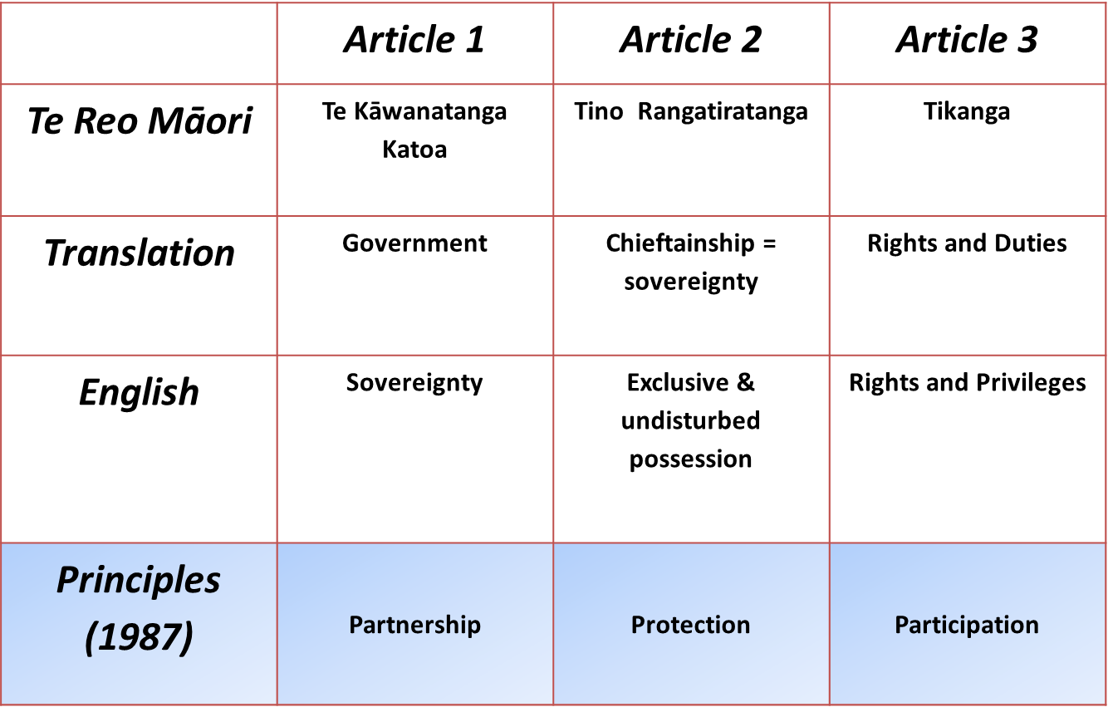
Treaty key points

